Slide 1


Advanced Deep Learning Driven Geospatial Analysis for GLOF Risk Reduction: A Case Study from Pakistan’s Northern Mountain Ranges
Nauman Ali Murad, Abinta Mehmood Mir, Nazia Shahzadi
Faculty of Computer Science and Engineering, GIK Institute, Topi, Swabi.
PRESENTED BY
Nauman Ali Murad
21st International Conference on Frontiers of Information Technology (FIT 2024)

Slide 2
Presentation Outline
PROBLEM STATEMENT
PROPOSED METHODOLOGY
CONCLUSION
INTRODUCTION
LITERATURE REVIEW
RESULTS AND DISCUSSIONS

Slide 3
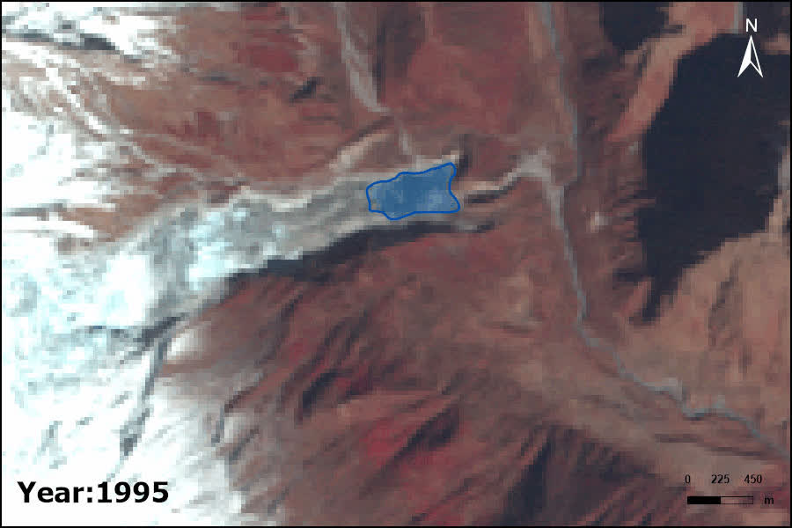
Introduction
Glacial Lake Outburst Floods (GLOFs) are high-magnitude, low-frequency events that result in catastrophic flooding and geomorphic changes.
Pakistan’s northern regions, particularly Chitral, are highly vulnerable to GLOFs due to rising temperatures causing glacial melt.
Our research employs advanced Deep Learning (DL) models for accurate segmentation and classification of glacial lakes using satellite imagery to improve GLOF monitoring and mitigation strategies.
Source: Insights behind the unexpected flooding in the Budhi Gandaki River, Gorkha, Nepal - ICIMOD

Slide 4
Problem Statement
Research Gap and Challenges:
Increasing frequency of GLOFs due to climate change.
Current methods for detection are resource-intensive and lack precision.
Socioeconomic impacts of GLOFs on vulnerable communities require actionable early-warning systems.
Existing studies fail to comprehensively evaluate state-of-the-art DL models for glacial lake segmentation and classification.

Slide 5
Literature Review
Title & Author | Year | Approaches | Results
A. Basit, M. K. Bhatti, M. Ali, T. Fatima, B. Minchew and M. A. Siddique, Deep Learning for Monitoring Glacial Lakes Formation using Sentinel 2 Multispectral Data [5] | 2022 | UNet & EfficientNetb0 | 79.90%
M. A. Siddique et al., "Towards Automated Monitoring Of Glacial Lakes In Hindu Kush And Himalayas Using Deep Learning," IGARSS 2023 - 2023 IEEE International Geoscience and Remote Sensing Symposium, [7] | 2023 | UNet & DeepLabV3+ | 72.81%
Automated mapping of glacial lakes using multisource remote sensing data and deep convolutional neural network [3] | 2022 | DCNN (GLNet) | 98%
Ali Washakh, R. M., Pan, X., Almas, S., Umar Waque, R. M., Li, H., Rahman, M., Majid, Z. (2024). Deep learning-based GLOF modelling for hazard assessment and risk management. [8] | 2024 | Shepard Convolutional Neural Networks (ShCNN) | 46%
Sharma, A., Prakash, C. Glacial lakes mapping using satellite images and deep learning algorithms in Northwestern Indian Himalayas. [13] | 2023 | U-Net | 94%

Slide 6
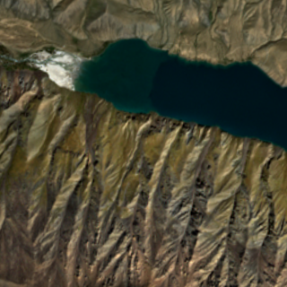
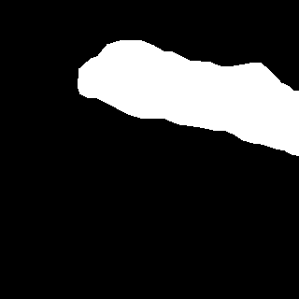
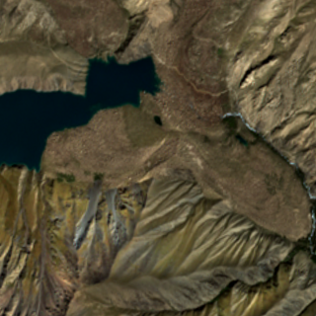
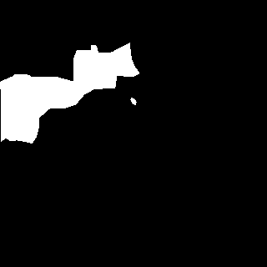
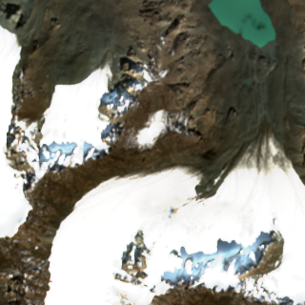
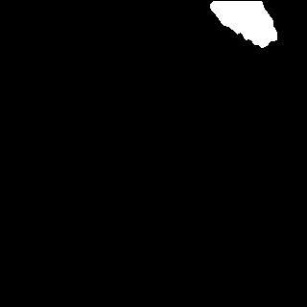
Dataset Description
Glacial Lakes Detection Dataset
Developed for training and evaluating AI models to detect and segment glacial lakes.
Crucial for GLOF risk assessment.
High-resolution Sentinel 2 satellite imagery from glacial regions of northern Pakistan.
Key Features:
Accurate annotations by experts.
Classes include glacial lakes and non-lake regions.
Diverse terrain representation.
Available on IEEE Dataport (M. A. Siddique, A. Basit).

Slide 7
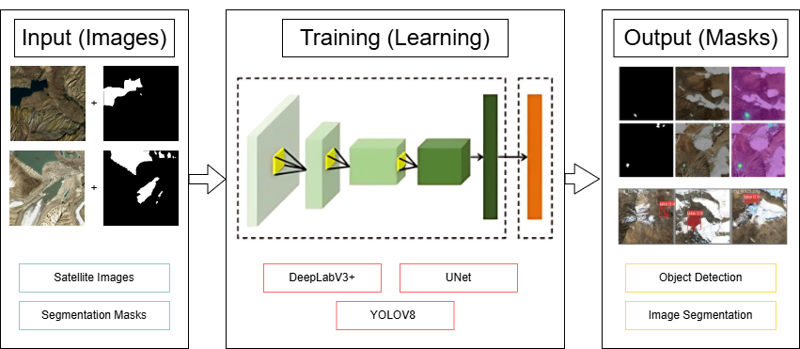
Proposed Methodology [1/3]

Slide 8
Proposed Methodology [2/3]
Model | Backbone | Loss Functions | Key Feature | Training Process | Hyperparameters
DeepLabV3+ | ResNet50 | Binary cross-entropy, Dice Loss | - Advanced decoder for segmentation - Utilizes ASPP for multi-scale context extraction | 50 epochs | LR = 1e-3 Optimizer: Adam
U-Net | ResNet50, EfficientNetB0 | Cross-entropy, Dice Loss | - Encoder-decoder architecture - Skip connections | 50 epochs | LR = 1e-3 Optimizer: Adam
YOLOv8-Seg | None | Localization loss | - object detection & segmentation - High accuracy for boundary delineation | 50 epochs | Auto

Slide 9
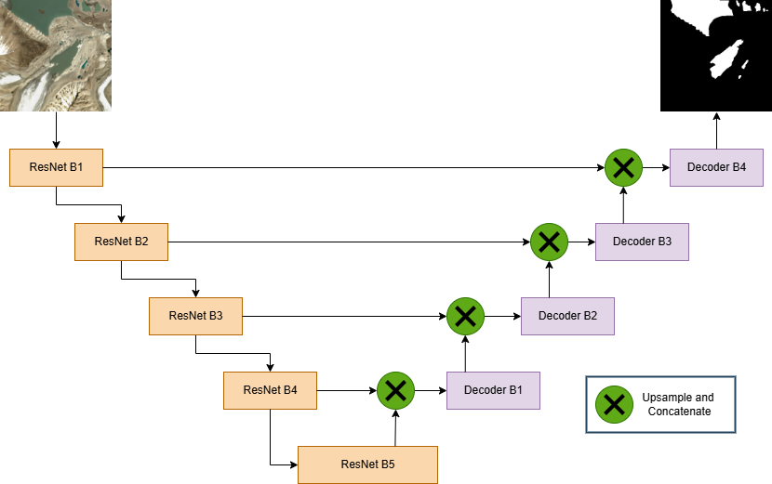
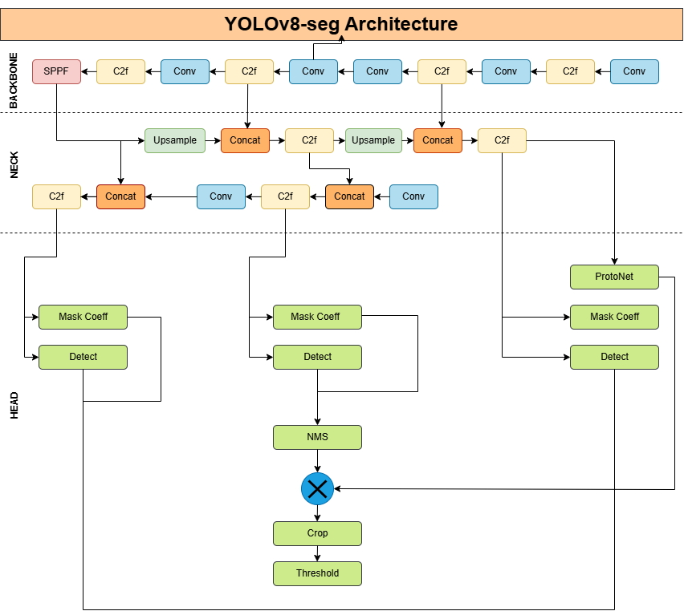
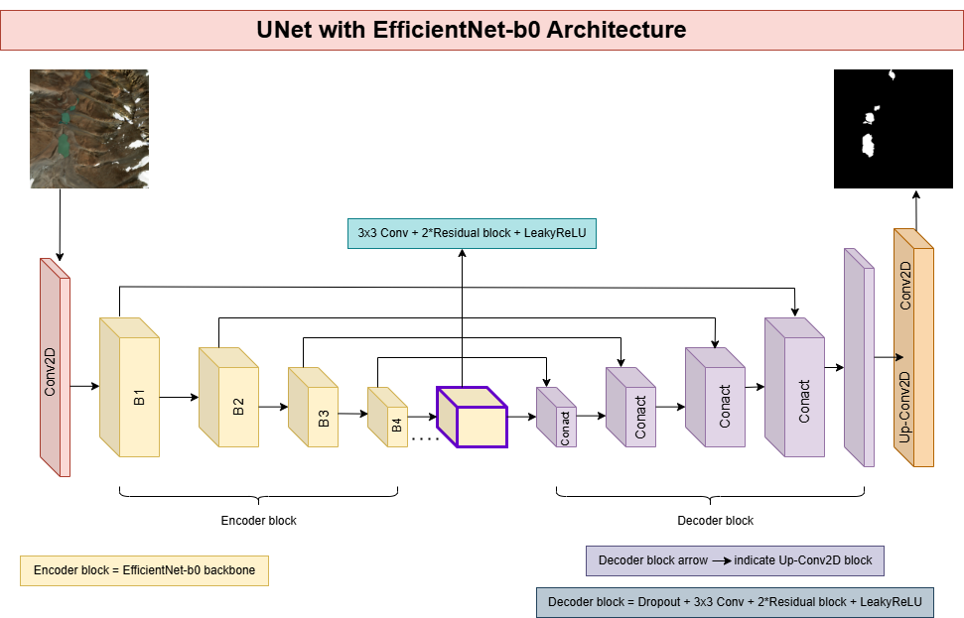
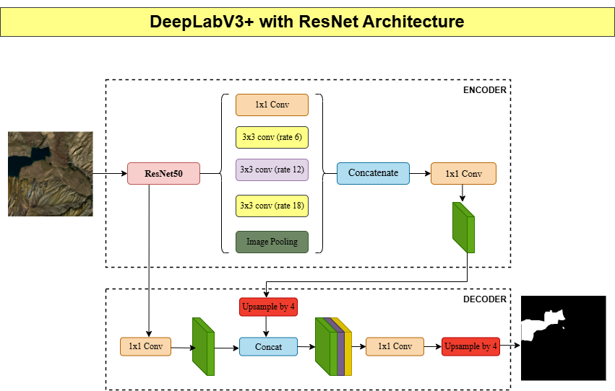
Proposed Methodology [3/3]
U-Net
YOLOv8-seg
U-Net with EfficientNet-b0
DeepLabV3+

Slide 10
Results
Model | Backbone | Loss function | IoU | Dice Coeff | Accuracy | Precision | Recall
DeepLabV3+ | ResNet50 | Cross entropy | 75.5% | 0.85 | 0.95 | 0.88 | 0.85
DeepLabV3+ | ResNet50 | Dice Loss | 79.2% | 0.86 | 0.78 | 0.93 | 0.82
U-Net | EfficientNetB0 | Cross entropy | 69.1% | 0.76 | 0.99 | 0.90 | 0.69
U-Net | None | Cross entropy | 65% | 0.56 | 0.99 | 0.69 | 0.72
U-Net | ResNet50 | Cross entropy | 59% | 0.74 | 0.99 | 0.88 | 0.68
YOLOv8 | None | Multiple | 72.9% | 0.73 | 0.89 | 0.90 | 0.84
*IoU (Intersection over Union) was our primary evaluation metric, assessing detection accuracy by measuring the overlap between predicted and actual bounding boxes or segmented regions.

Slide 11
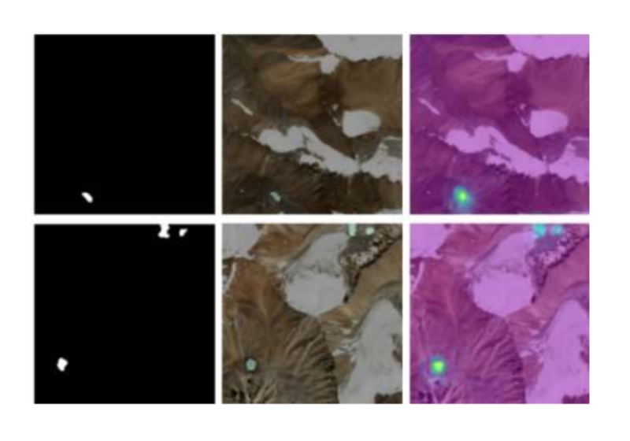
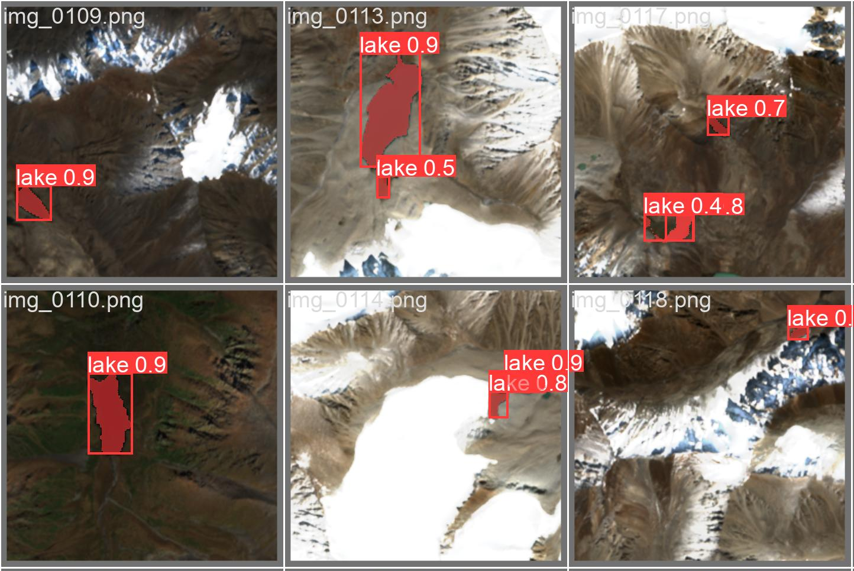
Result Discussion
Segmentation mask (detects glacial lake), overlay on original image (contextual visualization), and GradCAM (highlights regions influencing predictions).
IoU scores ranged from 65% to 79.2%, showcasing strong model performance.
DeepLabV3+ with Dice Loss achieved the highest accuracy at 79.2%.
Incorporating EfficientNetB0 backbone and Dice Loss significantly boosted results.
YOLOv8 achieved remarkable accuracy on our dataset, effectively detecting glacial lakes with high confidence scores.
Accurate segmentation is vital for GLOF detection, early warnings, and monitoring lake boundaries.
Methods can be extended to monitor hazards like landslides and flash floods.
Research enables real-time GLOF detection, aiding disaster management in vulnerable regions.

Slide 12
Future work
Address challenges of rugged terrain, limited infrastructure, and restricted data access in northern Pakistan.
Optimize algorithms for resource efficiency while maintaining accuracy in low-resource settings.
Reduce false alerts to prevent unnecessary evacuations and missed warnings.
Enhance deep learning architectures and segmentation techniques for better performance.
Expand focus to climate-induced hazards like landslides and flash floods by building targeted datasets and tools.
Develop real-time models for early warning systems integrated with disaster management.
Future work will refine loss functions, boost segmentation accuracy, and ensure scalability for real-world impact.

Slide 13
Conclusion
Monitoring GLOFs is crucial for addressing climate change impacts in high-altitude regions.
Our study used deep learning for glacial lake segmentation, with DeepLabV3+ (ResNet50) achieving 79.2% IoU, surpassing prior research.
High accuracy shows potential for real-world use in northern Pakistan, where GLOFs threaten lives and infrastructure.
This research enables timely monitoring, early warnings, and impactful detection systems.

Slide 14
References
[5] M. A. Siddique et al., "Towards Automated Monitoring of Glacial Lakes in Hindu Kush and Himalayas Using Deep Learning," IGARSS 2023
[6] A. Basit and M. A. Siddique, "Glacial Lakes Detection Dataset," IEEE Dataport, July 4, 2022.
[12] M. F. Muneeb, S. U. Baig, J. A. Khan, and M. F. Khokhar, "Inventory and GLOF Susceptibility of Glacial Lakes in Hunza River Basin, Western Karakorum," Remote Sensing, vol. 13, no. 9, p. 1794, 2021.
[11] Zhiyuan Xie, Vijayan K. Asari, Umesh K. Haritashya, Evaluating deep-learning models for debris-covered glacier mapping, Applied Computing and Geosciences,
[14] Zhang M, Chen F, Zhao H, Wang J, Wang N. Recent Changes of Glacial Lakes in the High Mountain Asia and Its Potential Controlling Factors Analysis. Remote Sensing. 2021; 13(18):3757.
[13] Z. Zhou, M. M. R. Siddiquee, N. Tajbakhsh, and J. Liang, “UNet++: Redesigning skip connections to exploit multiscale features in image segmentation,” IEEE Trans. Med. Imag., vol. 39, no. 6, pp. 1856–1867, Jun. 2020
[3] S. K. Allen et al., “Potentially dangerous glacial lakes across the Tibetan Plateau revealed using a large-scale automated assessment approach”, Sci. Bull., vol. 64, no. 7, pp. 435-445, 2019.
[9] Ronneberger (2015). U-Net: Convolutional Networks for Biomedical Image Segmentation.

Slide 15


Thank you for listening!
Please ask your questions.

